Slide 1
PHC AI - Malaria Prevalence Predictor & Bio‑Health Tracker
MLP (Multilayer Perceptron) Deployment: Website & Power BI integration
Prepared by: Team – Data Sages for Africa
12/10/2025

Slide 2
Executive Summary
Objective: Predict malaria prevalence across Nigeria using environmental & demographic covariates and deliver actionable decision support at PHC level.
Deliverables: Trained MLP model, web prototype with bio‑health tracker, Power BI dashboard integration, and scale/impact plan.
Outcome: Early-warning forecasts, targeted resource allocation, and improved primary health care planning.

Slide 3
Data Landscape & Sources
Spatial units: DHS clusters / facility catchments (site-level identifiers).
Covariates: “Population_Count", "Aridity", "Malaria_Incidence", "Mean_Temperature", "Precipitation", "Rainfall",
Label: Malaria_Prevalence (survey-based or surveillance-derived).
Primary sources: NDHS, WorldPop, Malaria Atlas Project (MAP), HDX, and DHIS2.

Slide 4
Model Overview — MLP (Multilayer Perceptron)
Input: Site-year feature vector (covariates + temporal lags + spatial features).
Architecture: Input layer → Dense(256) → BatchNorm → Dropout → Dense(128) → BatchNorm → Dropout → Output(1).
Loss & metric: MSE loss, MAE as evaluation metric. EarlyStopping used during training.
Why MLP: Robust baseline for tabular data, fast to train, easy to interprete with feature attributions.

Slide 5
Training Strategy & Evaluation
Training window: 2000–2015 (annual interpolated series). Test: 2020.
Cross-site pooling: model trained across all sites to leverage spatial patterns.
Feature engineering: lags, rolling averages, seasonal encodings (month sine/cos), spatial neighbor means.
Evaluation: MAE & RMSE on hold-out 2020; visual inspection of predicted vs observed maps and time series.

Slide 6
Model Performance & Diagnostics
Key metrics on test (2020): MAE = 0.0452, loss = 0.0025
Diagnostics: residual maps, predicted vs observed scatter plots, distribution of errors by region.
Overfitting checks: training vs validation loss curves, early stopping behavior.
Feature importance: SHAP summary shows top contributors (e.g., rainfall, EVI, ITN coverage, nightlights).

Slide 7

Forecasting & Scenario Analysis
Forecast years: 2026, 2027, 2028.
Covariate projection: linear trend extrapolation or policy-driven scenarios (optimistic, pessimistic).
Output: site-level prevalence forecasts which can be aggregated to LGA/State for resource planning.

Slide 8



Prototype:- Website & Bio‑Health Tracker Web Application
Features: user registration, personal health profile, symptom log, recommended clinic visits based on forecasts.
Model integration: frontend calls Predict API to get site-year prevalence forecasts and recommended actions.
Privacy: minimal PII storage, encryption-at-rest, role-based access control for health workers.

Slide 9

Power BI Dashboard Integration
Dashboard components: clinic distribution map, prevalence heatmap, stockout alert table, utilization trends.
Embed approach: host PBIX on Power BI Service and embed via iframe and publish to web for judges.
Data connectors: streaming endpoint from backend for live updates (or periodic batch updates).
Value: policy-friendly visuals for health managers and NHIS planners.

Slide 10
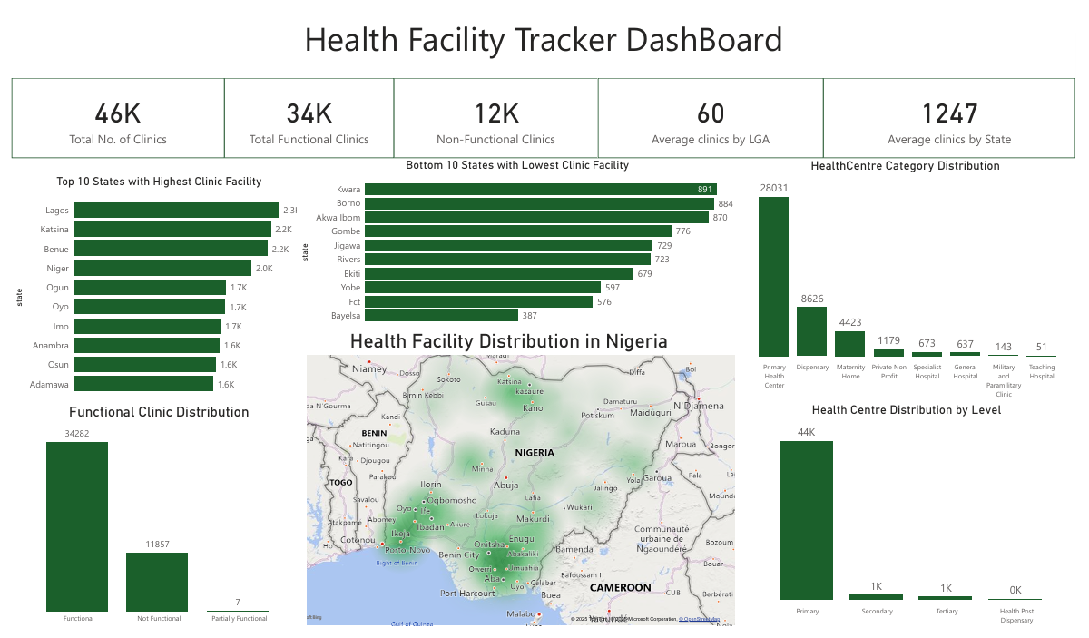
Web Application Dashboard Feature

Slide 11

Scaling Strategy: Nigeria & Beyond
Phase 1: Pilot (selected states); validate model, integrate DHIS2 feeds, local partnerships with different States.
Phase 2: Regional rollout; integrate national facility registries, local language packs, train local admins.
Phase 3: Continental scaling; adapt covariate sources per country, modular connectors for DHIS2/HDX and WorldPop.
Operational needs: cloud hosting, CI/CD pipeline, model retraining cadence, local data governance.

Slide 12

Local Context & Language Localization
Local relevance: model uses local climatic, socio-economic, and access indicators to reflect Nigeria's heterogeneity.
Language support: UI translations and TTS for English, Yoruba, Hausa, Igbo, Pidgin; local terminology for symptoms.
Community buy-in: co-design workshops with CHWs and facility managers to ensure culturally appropriate prompts.
Training & materials: localized SOPs, short video guides, and quick-reference SMS/USSD summary flows.

Slide 13
Offline-first & Low-connectivity Features
Client-side caching: store recent predictions, user logs, and forms in local storage or SQLite (mobile).
USSD & SMS fallback: lightweight menus for feature-phone users to access risk summaries and nearest clinic.
Sync strategy: background sync when connectivity available; conflict resolution rules for clinic reports.
Lightweight payloads: compress model responses and use small JSON payloads; lazy-load map tiles.

Slide 14

Impact Metrics & Monitoring
Operational metrics: stockout reduction %, timely referrals, predictions accuracy (MAE by region).
Health outcomes: reduction in malaria incidence, reductions in severe cases, improved ANC attendance.
Adoption metrics: active CHWs, facilities using the dashboard, API calls per month, retention.
Equity metrics: change in service coverage for top 20% underserved LGAs; gender-disaggregated use.

Slide 15
Sustainability & Funding Model
Open-source core with paid managed services for hosting, premium analytics and SLAs for ministries.
Partnerships: state health agencies, NGOs (e.g., Malaria Consortium), donors (GAVI, Global Fund).
Revenue streams: subscription for advanced reports, capacity-building workshops, integration services.
Governance: data-sharing MOUs, local data custodians, and compliance with national health data policies.

Slide 16
Key Takeaways & Next Steps
We built an MLP-based malaria prevalence predictor integrated into a website that has a Power BI dashboard incorporated.
Actionable outputs: site-level forecasts, triage and symptoms guidance for patience, and visual tools for policymakers.
Next steps: pilot in 2 states, connect live DHIS2 feeds, expand language support, and hold CHW trainings.
Ask: funding for pilot, MOH partnership, and technical resources for deployment & monitoring.

Slide 17
Appendix: Technical Details
Data pipeline: ingestion (raw) → cleaning → interpolation → feature engineering → model training.
Model artifacts: model.h5, scaler.joblib, feature list, SHAP explanation artifacts.
Deployment: FastAPI model endpoint, frontend fetch, Power BI connector for batch updates.
Reproducibility: Dockerfile, CI scripts, and README with run instructions.

